Slide 1
Exploration of attributes of best employers globally and contributing factors
Project 1 | Group 6
Gavin Payne; Rohan Liyanage; Timo Nugraha; Javier Gausachs

Slide 2

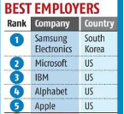
Research Questions
Starting point: Forbes 2022 Ranking of 100 Best Employers
What is it?
How is it formulated?
Why are we interested?
Complemented with: Glassdoor Preferred Employer Scores
Our research questions:
What are the attributes of good employers?
Are good employers good companies?
Are there any other factors that may contribute to being good employer?
Notes:
Forbes b/g: The initial research was undertaken Statista, who surveyed 150,000 full-time and part-time workers from 57 countries working for multinational companies and institutions to measure their performance on tenants such as: corporate impact and image, talent development, gender equality and social responsibility.
Context (why): Since covid, a) employee priorities have shifted
b) employers: have had the talent pool depleted, have had to offer more flexibility to attract, retain.
c) 2022 list: those frictions have played out and had time to feed into the 2022 list.
Questions: State as above.

Slide 3
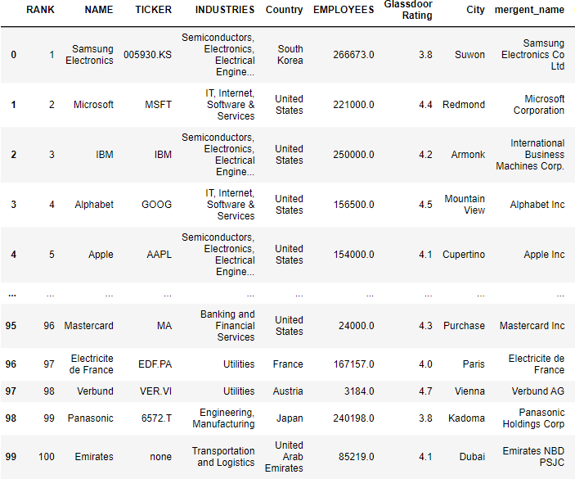
Preliminary Analysis – Look into Forbes / Glassdoor
Source:
Kaggle / Forbes dataset: https://www.kaggle.com/datasets/devrimtuner/worlds-best-employers-top-100
Glassdoor Rating site: https://www.glassdoor.com.au/member/home/index.htm
Notes:
Our approach part 1: exploration of the source research to look at the features/attributes of the ‘Top 100’
What kind of companies made up the top 100?

Slide 4
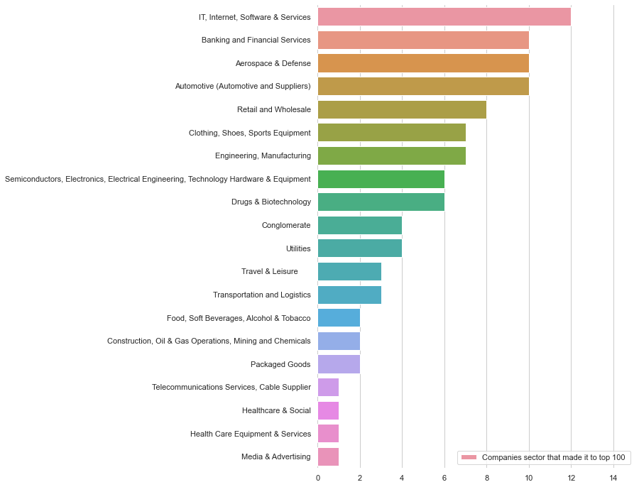


Preliminary Analysis – Sector Analysis
20 sectors made it into top 100 employers in 2022
[Timo’s graph here]

Slide 5
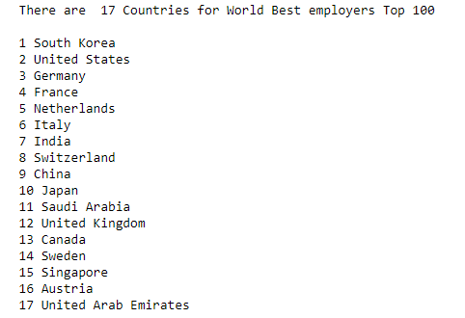
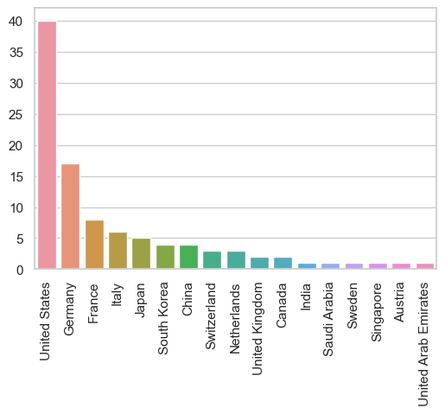
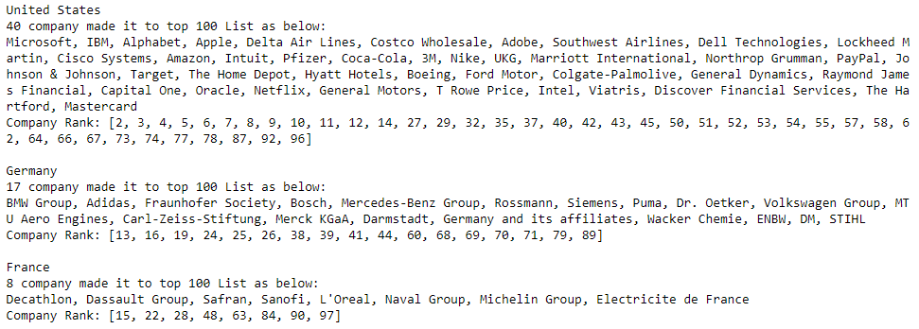
Preliminary Analysis – Company Analysis
Number of companies in each country in top 100

Slide 6
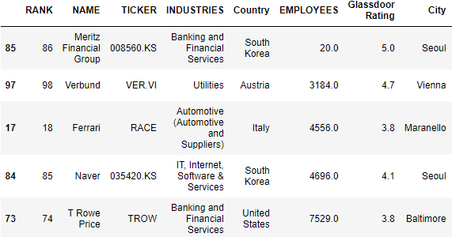
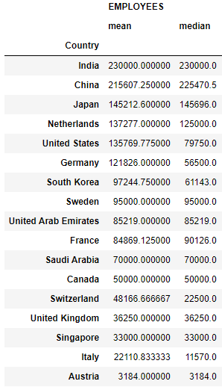
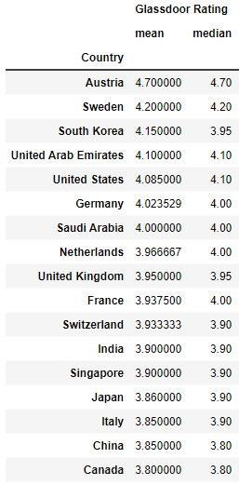
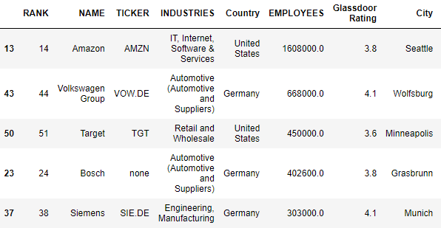
Preliminary Analysis – Company Analysis

Slide 7
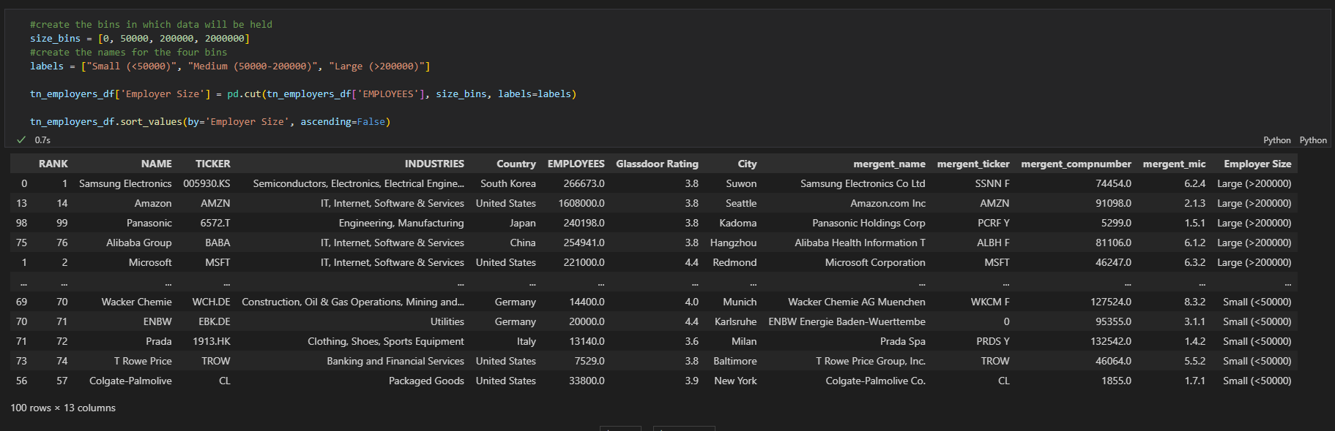
Preliminary Analysis – Forbes Ranking vs Glassdoor Ratings

Slide 8
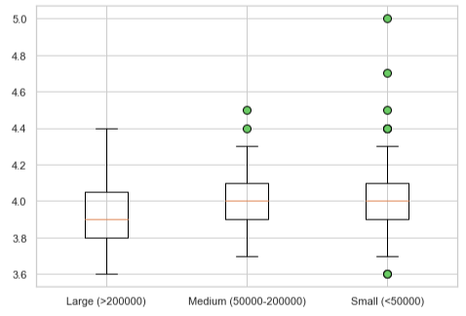
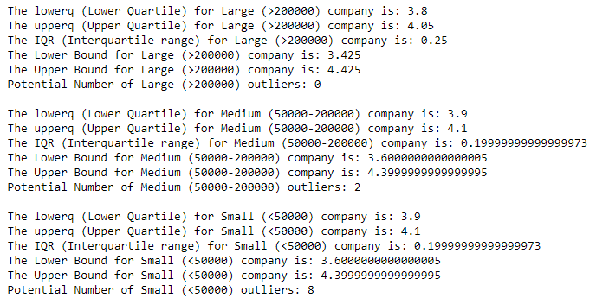
Preliminary Analysis – Forbes Ranking vs Glassdoor Ratings

Slide 9
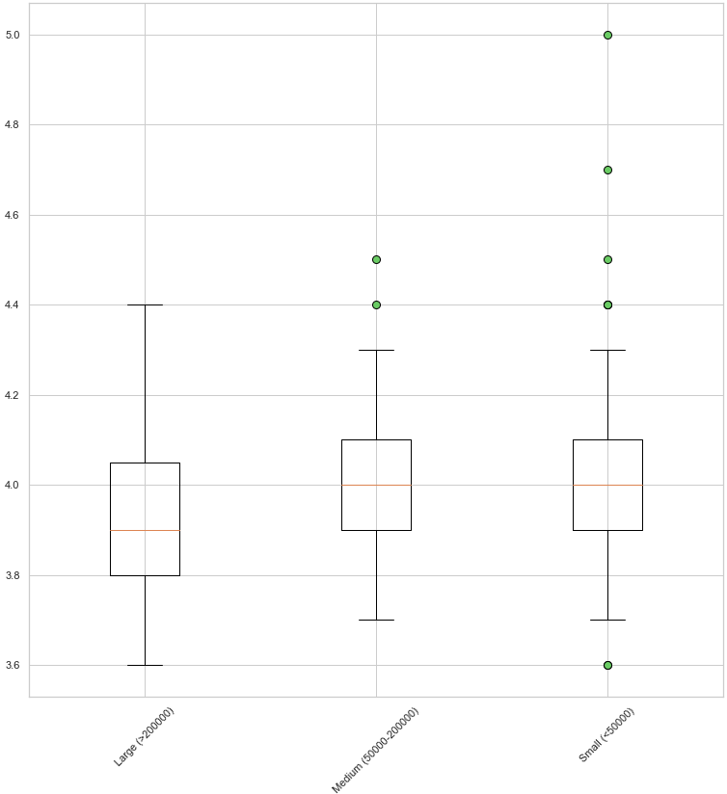
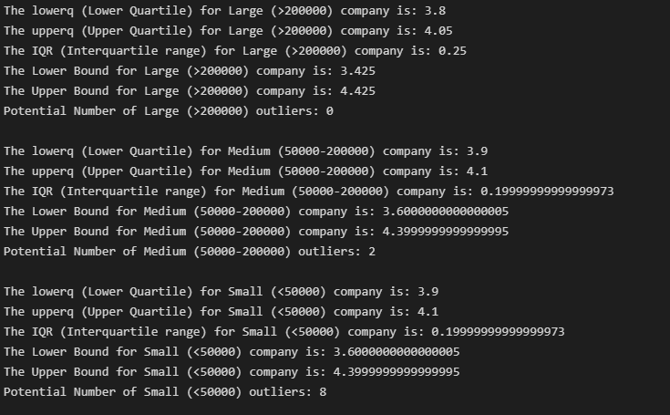
Preliminary Analysis – Forbes Ranking vs Glassdoor Ratings

Slide 10
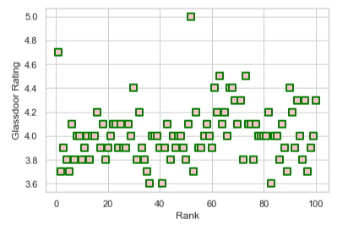
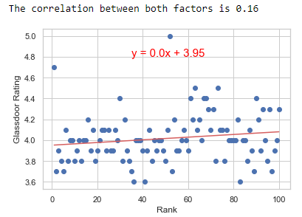
Preliminary Analysis – Forbes Ranking vs Glassdoor Ratings

Slide 11
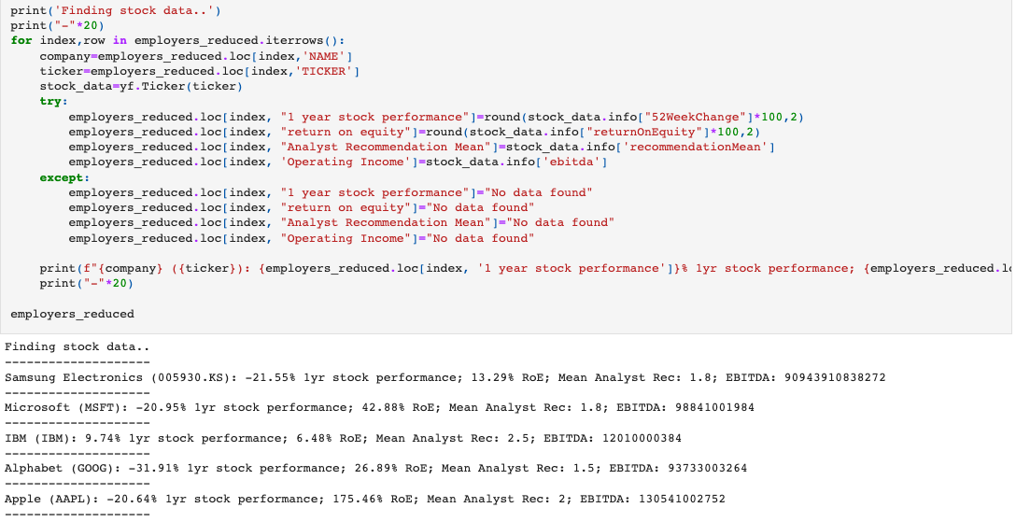
Are good employers good companies? – Look within Top 100
Source : Yahoo Finance data feed
Approach: Bring in finance data via the ticker code to see whether success as an acclaimed employer converts to financial performance.
Notes:
Our approach part 1: bringing in finance data via the ticker code so see whether success as an acclaimed employer converts to financial performance.
Yahoo Finance library wrapper.
Financial metrics:
12-month stock performance, ROE (shareholder value),
average of analyst recommendations (1 strong buy, 5 strong sell), operating income per all available in the yf.ticker.info method.
Results (raw) :
Appears to be no correlation between ranking in the top 100, and financial performance.
Already 100 high performing companies, multinationals, likely got in that position by being financially sound.
Results (standardized):
Cluster around mean, particularly ROE.
Stock price contained more variation, this may have to do with broader sector performance

Slide 12
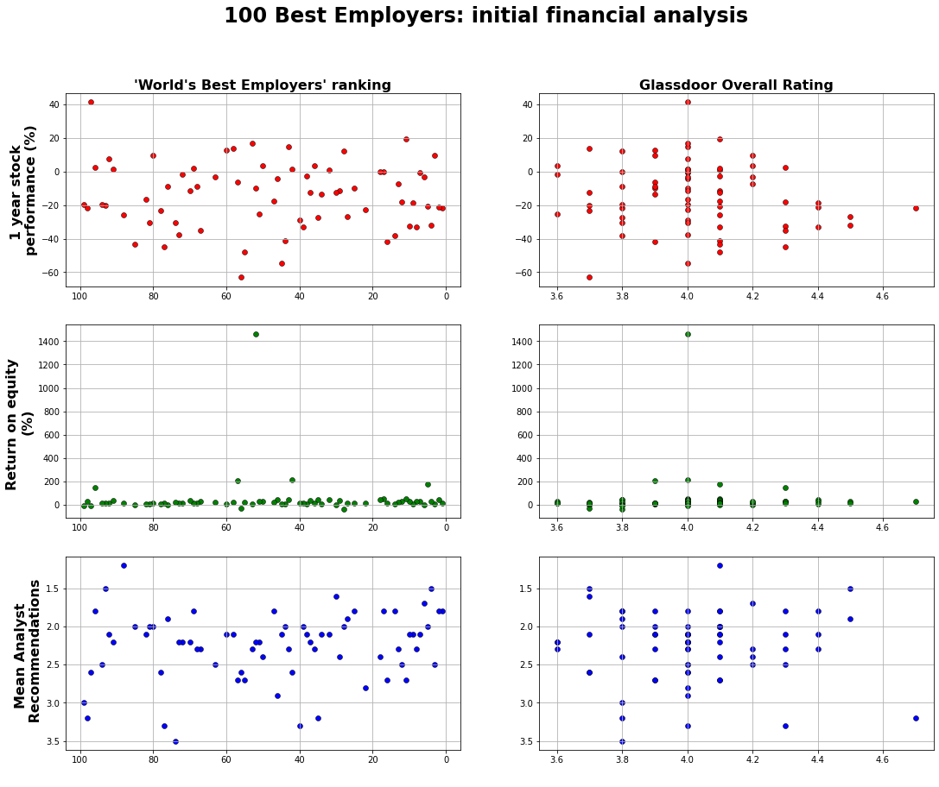
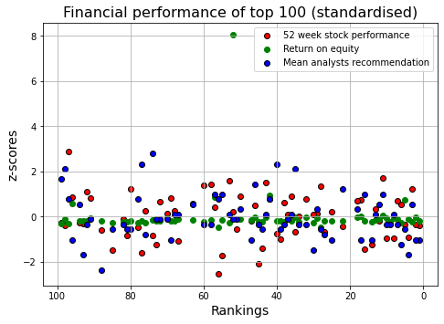
Are good employers good companies? – Look within Top 100
Approach: Plot the employer rankings/ratings against chosen financial metrics
Notes:
Our approach part 1: bringing in finance data via the ticker code so see whether success as an acclaimed employer converts to financial performance.
Yahoo Finance library wrapper.
Financial metrics:
12-month stock performance, ROE (shareholder value),
average of analyst recommendations (1 strong buy, 5 strong sell), operating income per all available in the yf.ticker.info method.
Results (raw) :
Appears to be no correlation between ranking in the top 100, and financial performance.
Already 100 high performing companies, multinationals, likely got in that position by being financially sound.
Results (standardized):
Cluster around mean, particularly ROE.
Stock price contained more variation, this may have to do with broader sector performance.

Slide 13
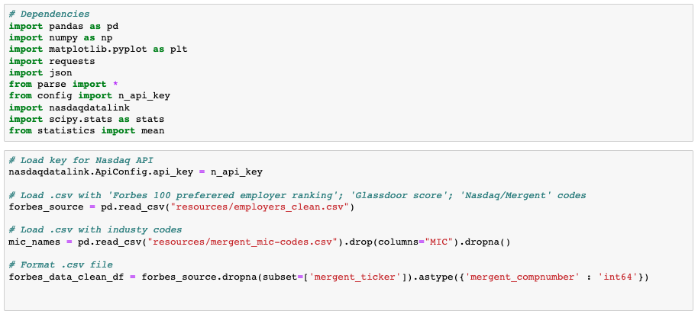
Are good employers good companies – Look at sector peers
Source : Nasdaq API and ’Mergent Global Finance’ data feed
Approach: Analyse Return on Equity (ROE) - as the chosen performance metric for comparing acclaimed employers to sector peers. Bring in ROE for 2022 for sector companies and compare against ranked companies.
Notes:
Our approach part 2: Financial information for Top 100 relative to their industry peers.

Slide 14
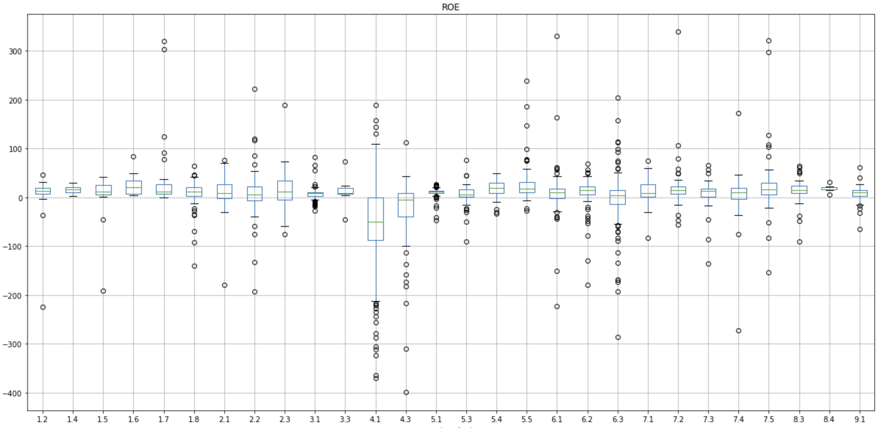
Are good employers good companies – Look at sector peers
Approach: Bring in ROE for CY 2022 from each relevant sector. Trim outliers i.e., ROEs above/below ± 300%.
ROE
of companies
In sector :
Notes:
Our approach part 2: Financial information for Top 100 relative to their industry peers.

Slide 15
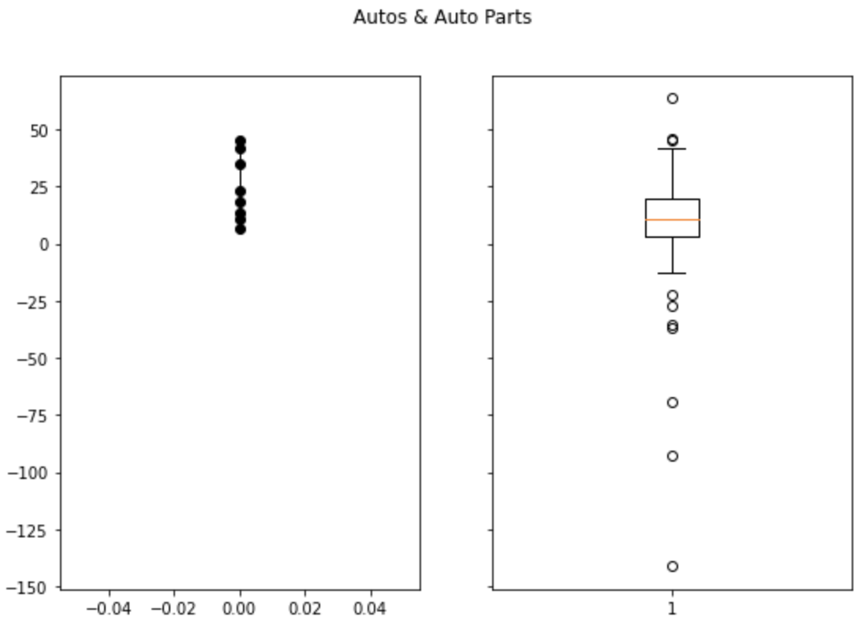
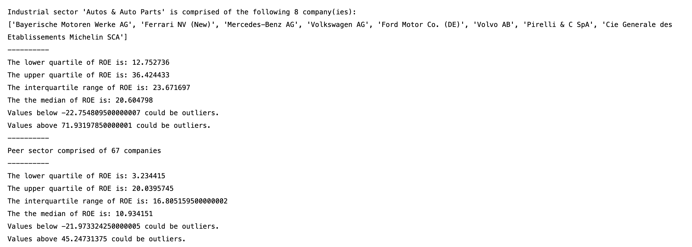
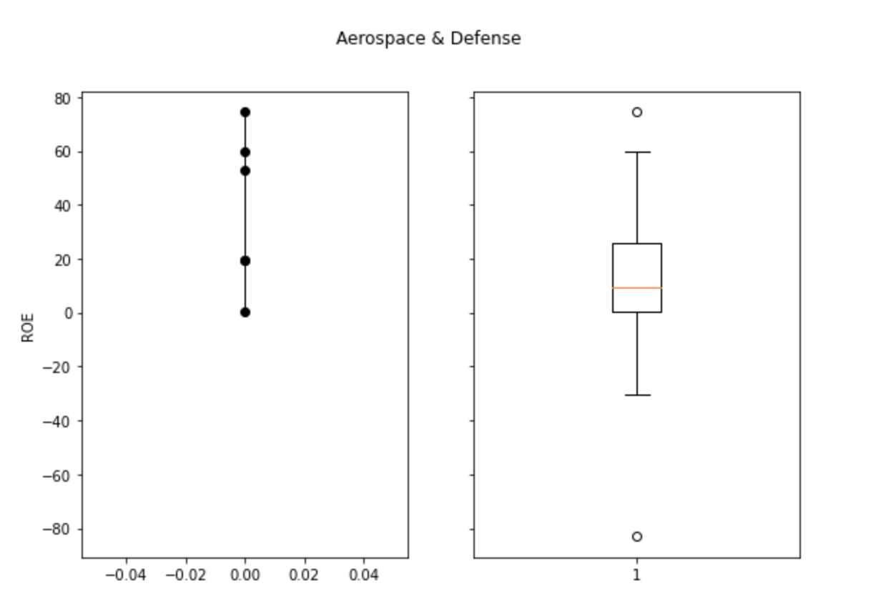
Are good employers good companies – Look at sector peers
Illustrative sector: ROE in Auto & Auto Parts industry
Acclaimed employers
Sector peers
Notes:
Our approach part 2:
ROE for acclaimed employers relative heir sector peers.
Selected 3 sectors with most employers : Automobile / Aerospace and Defense / Pharmaceuticals and Biotech
ROE of acclaimed companies on the left. ROE of sector peers on the right.
For Auto & Auto parts : 8 preferred employers against sector of 67 companies
Observation: Acclaimed employers in the Auto & Auto parts sector have superior ROE relative to peers, with median ROE 21% - and lower quartile ROE 13% - v median ROE 11% for peers.

Slide 16
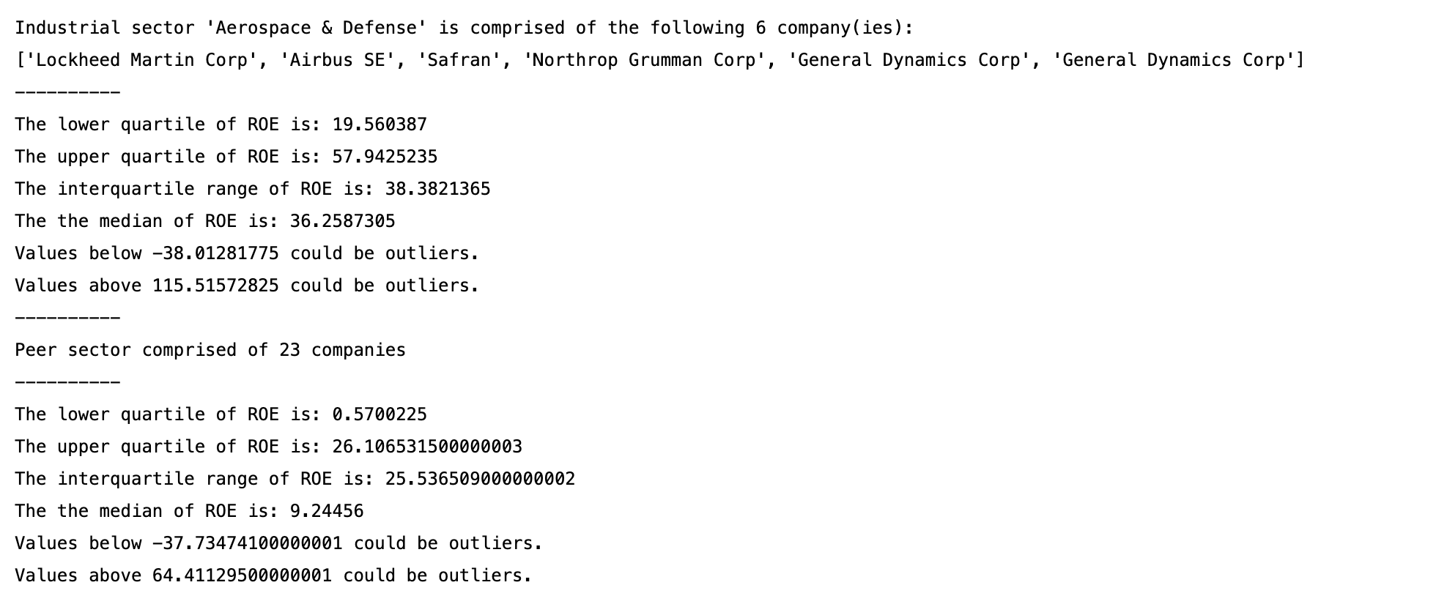
Are good employers good companies – Look at sector peers
Illustrative sector: ROE in Aerospace & Defense industry
Acclaimed employers
Sector peers
Notes:
Our approach part 2:
For Aerospace & Defense : 6 preferred employers against sector of 23 companies
Observation: Acclaimed employers in the Aerospace & Defense sector have superior ROE relative to peers, with median ROE 36% - and lower quartile ROE 20% - v median ROE 9% for peers.

Slide 17
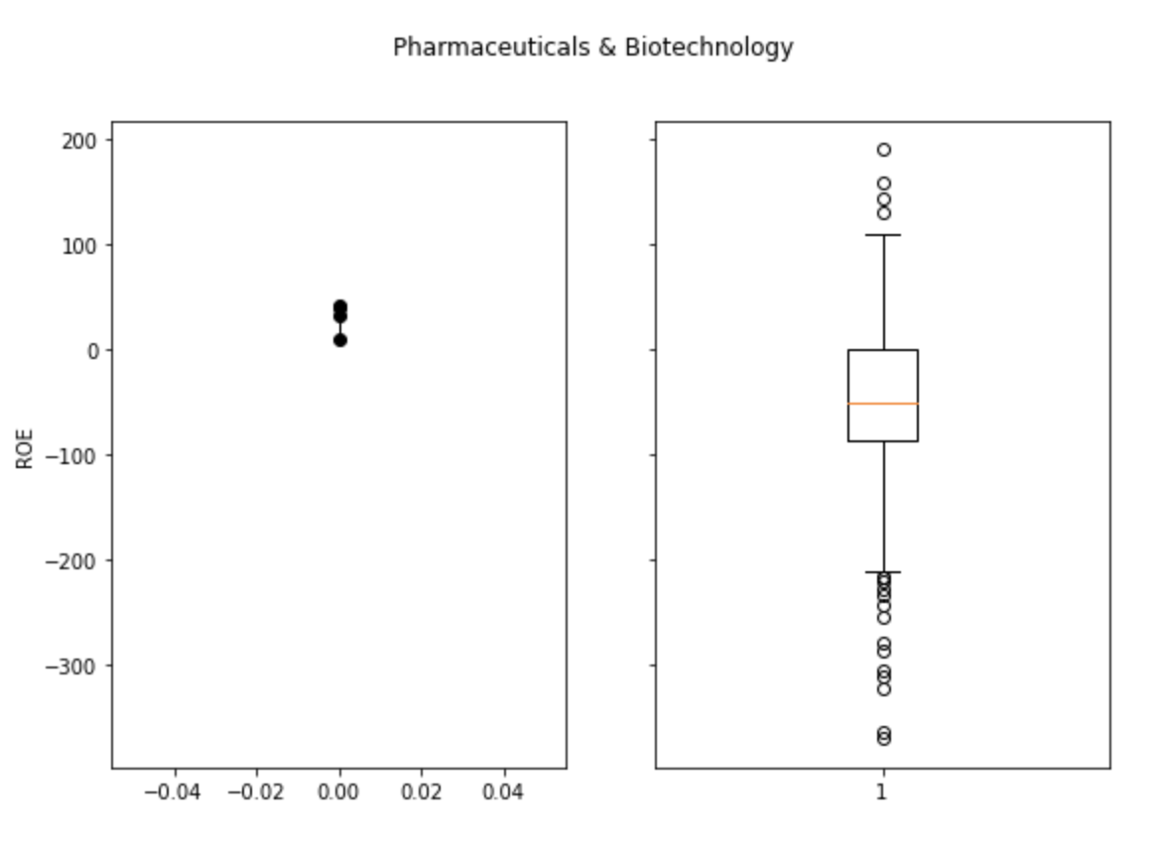
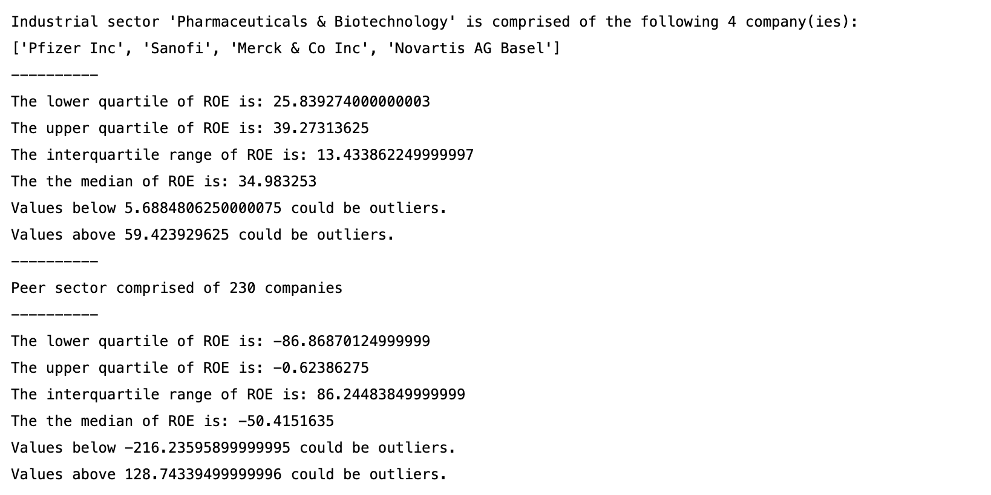
Are good employers good companies – Look at sector peers
Illustrative sector: ROE in Pharmaceuticals & Biotechnology industry
Acclaimed employers
Sector peers
Notes:
Our approach part 2:
For Pharmaceuticals & Biotech: 4 preferred employers against sector of 230 companies
Observation: Acclaimed employers in the Pharmaceuticals & Biotech sector have superior ROE relative to peers, with median ROE 35% - and lower quartile ROE 25% - v median ROE -50% for peers.
For sectors with 3 or more employers represented in the Forbes ranking (4 sectors) the performance of preferred employers as measured by ROE is significantly above that of the sector peers. Preliminary statistical independent t-test analysis confirms this. More work required.

Slide 18
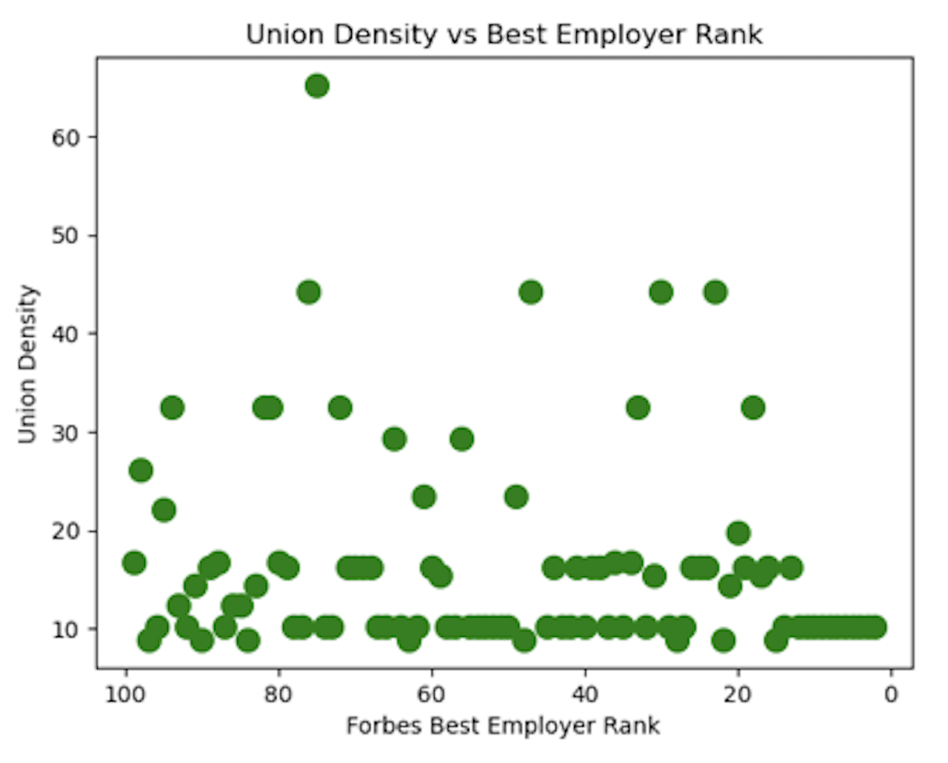
Other factors contributing to being good employer
Measure of union density^ for Forbes Top 100 employers
Investigate whether the best ranked
employers have the best union
Representation
^ Union density : number of trade union members who are employees as a percentage of the total number of employees. Source : ILO Stats
Notes:
Our approach part 3: Many countries represented in the top 100 (though mostly US and Germany)
Geographic/Demographic factors
Is there something about employees from these countries that predisposed them to feel a certain way about their employers

Slide 19
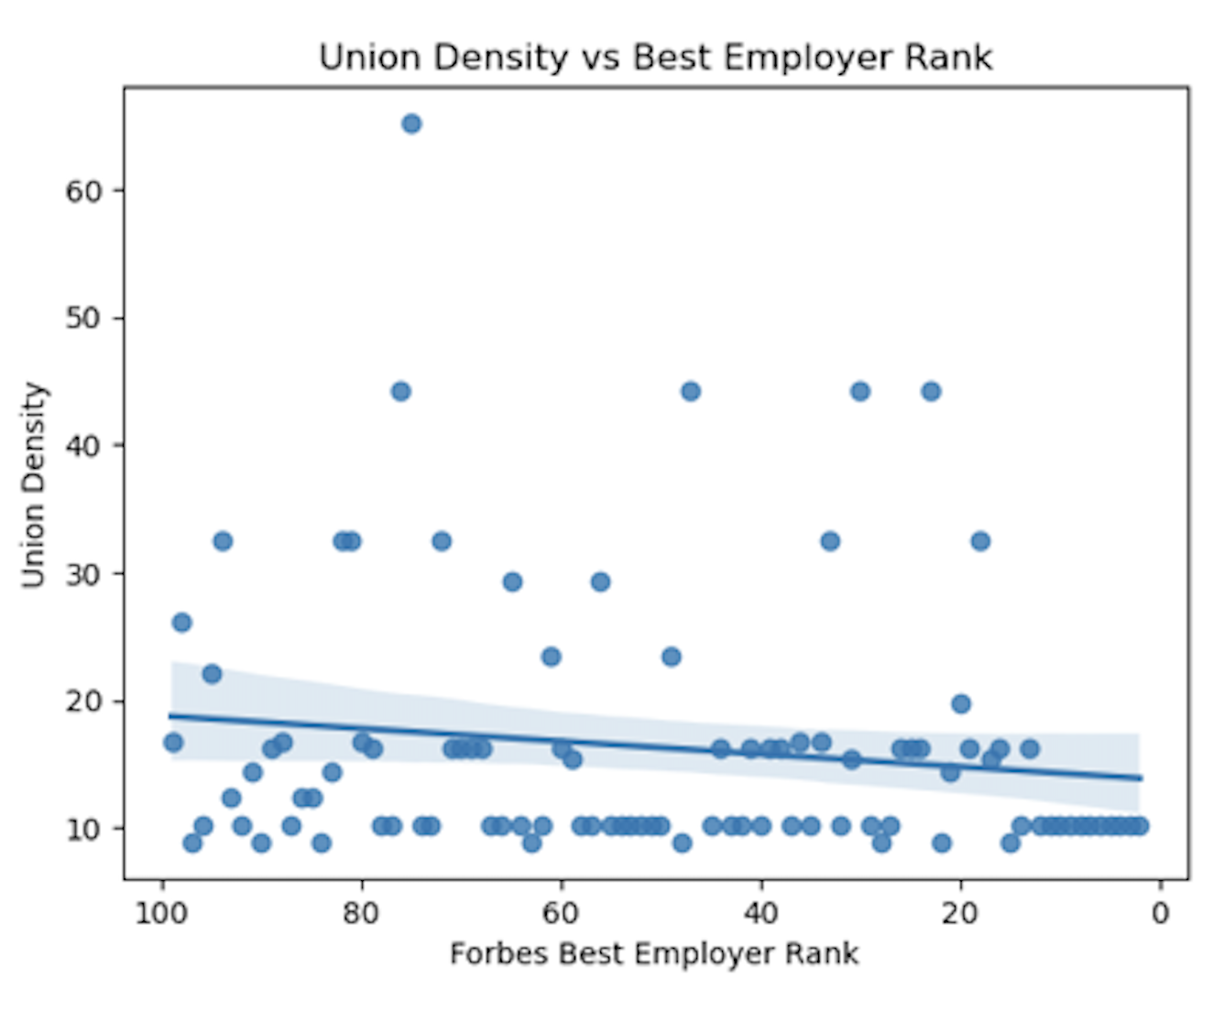
Other factors contributing to being good employer
Measure of union density^ for Forbes Top 100 employers
Investigate the relationship between
best ranked employer and union
Representation
Correlation between
Union Density and
Best Employer Rank is 0.14
^ Union density : number of trade union members who are employees as a percentage of the total number of employees. Source : ILO Stats
Notes:
Our approach part 3: Many countries represented in the top 100 (though mostly US and Germany)
Geographic/Demographic factors
Is there something about employees from these countries that predisposed them to feel a certain way about their employers

Slide 20
Conclusions
Did the data uncover any answers to our initial research questions?
We conclude:
Acclaimed employers are established, longstanding companies, scoring well on multiple surveys
Tend to have superior returns to sector peers
No strong correlation with unionisation at country level
Further work:
Cause and effect of performance v preferred employer status
Investigate common root causes – superior leadership, strategic direction, high brand recognition/value
Statistical analysis – significant differences
More demographic factors and response breakdown at country level
Notes:
- Acclaimed employers in the ranking tend to be established, longstanding companies. Not much dispersion in the performance of those employers amongst themselves. The employers highlighted by Forbes also score well with Glassdoor
- Acclaimed employers tend to have superior return to sector peers as observed by return on equity in the year of the survey for sector with 3 or more peers
Did not observe any strong correlation between level in the ranking and the unionisation in the country of origin of the company
We focused on understanding whether being a preferred employer translated into good financial performance, ought to investigate if financial performance in itself influences rankings and scores
There could be common root cause explaining both results, management leadership, strategy of the company, and brand value market, and customers
Need to apply statistical tests to confirm the ROE performance of ranked companies is significantly different to that or peers
And finally, ought to expand our analysis to more demographic factors associated to scores of companies at country level

